Slide 1

Results Visualization Summary
Model Evaluation Metrics & Image Quality
Presented by Samiyeel Mubtasim Atique and Tamjid

Slide 2
Presentation Objectives
Model Performance
Image Quality Comparison
Restoration Assessment
Visually represent model behaviour throughout the training phase, focusing on key performance indicators.
Present a side-by-side analysis of low-quality, restored, and high-quality ground truth images.
Utilise objective metrics, specifically PSNR and SSIM, to quantify the effectiveness of the image restoration process.

Slide 3
Key Metrics Overview
Our evaluation relies on a comprehensive set of metrics extracted directly from the training logs. These metrics provide critical insights into model stability and performance.
Epoch
The current training iteration, indicating progression.
Train Loss
Measures the model's error on the training dataset.
Val Loss
Measures the model's error on the validation dataset, indicating generalization.
PSNR
Peak Signal-to-Noise Ratio, assessing image quality between original and reconstructed image.
SSIM
Structural Similarity Index Measure, evaluating perceived similarity between images.
These metrics are systematically loaded from the metrics.csv file for consistent analysis.

Slide 4
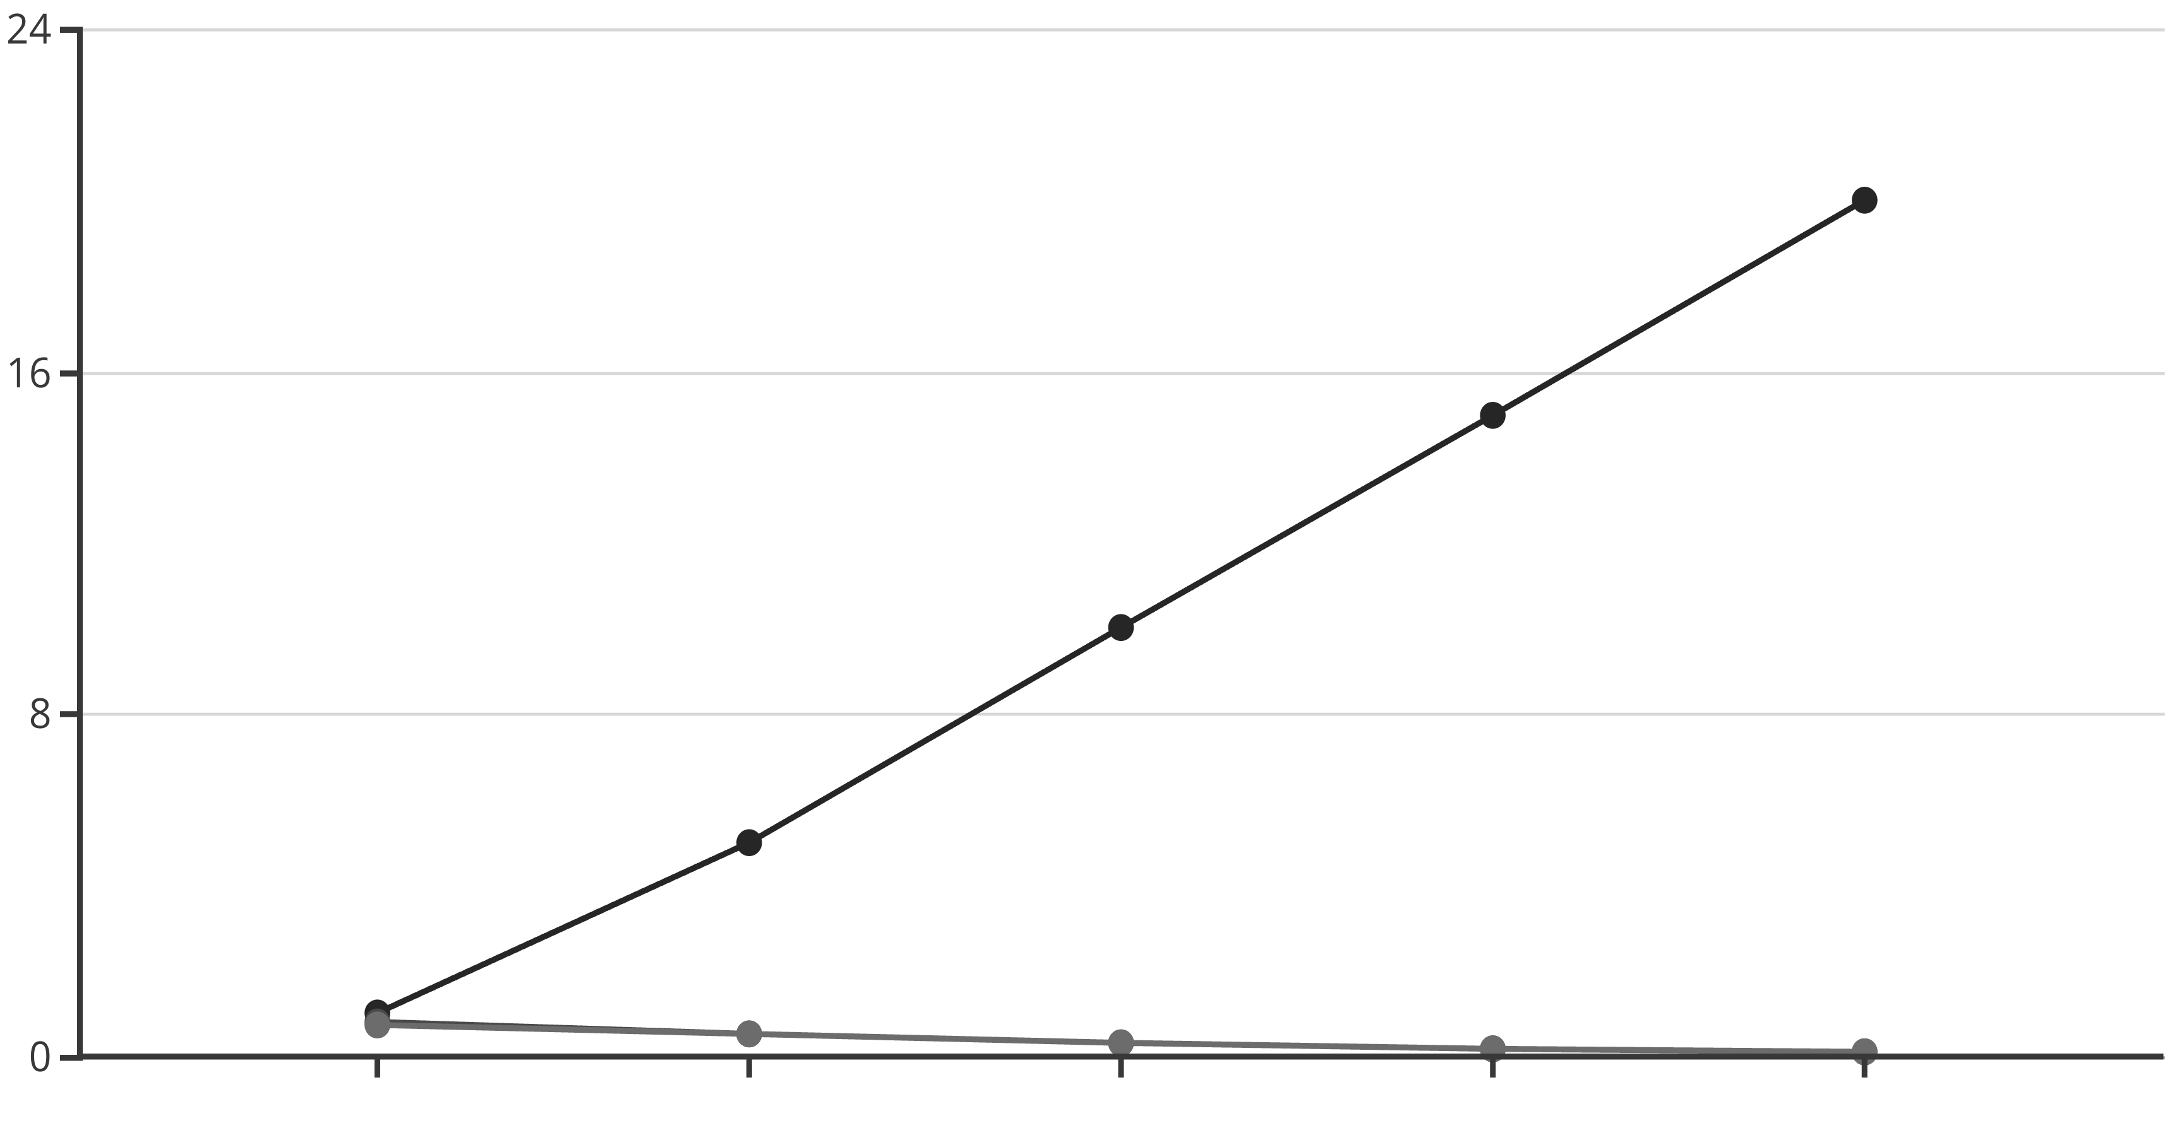
Loss Progression Over Epochs
Epoch
Train Loss
Validation Loss
The line chart illustrates the model's convergence, showing how both training and validation loss steadily decrease with each epoch. This indicates the model is effectively learning and improving its fit to the data without significant overfitting.

Slide 5
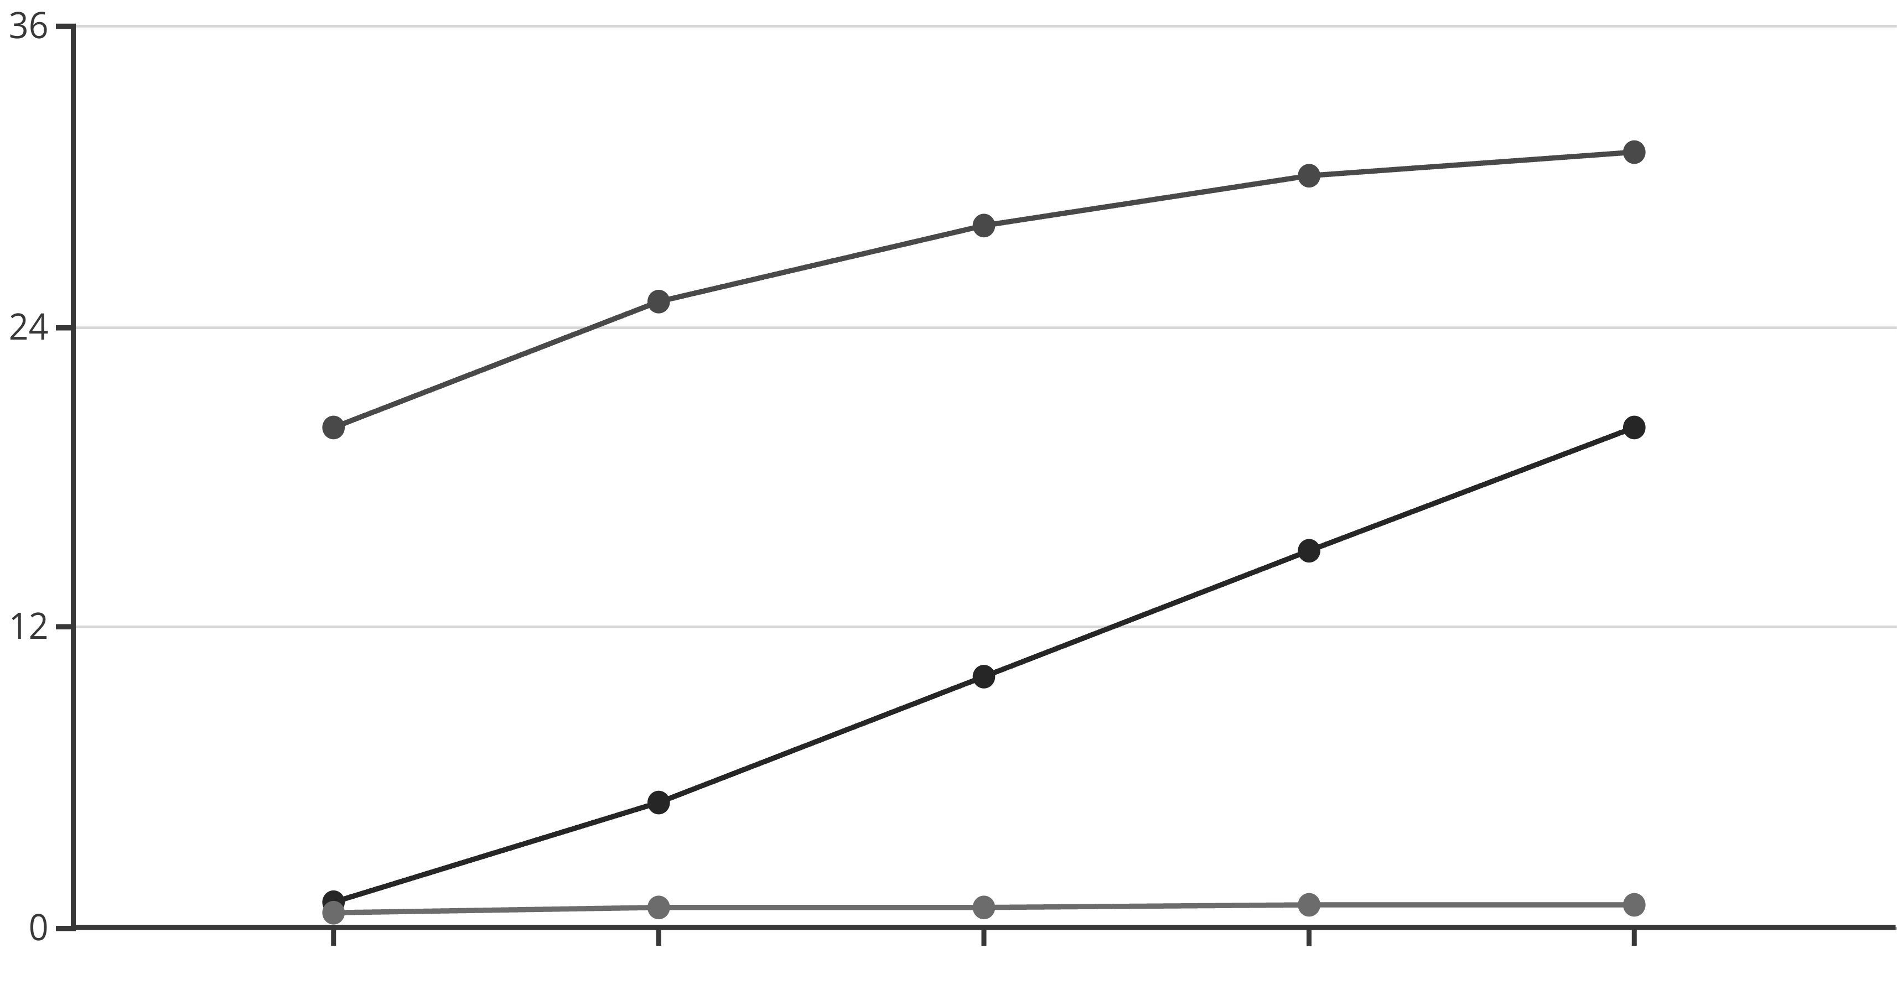
PSNR & SSIM Evolution
Epoch
PSNR
SSIM
This chart tracks the improvement of PSNR and SSIM scores throughout training. Rising PSNR values signify higher image quality, while increasing SSIM scores indicate a greater perceived similarity to the ground truth. This trend confirms the model's effectiveness in enhancing image fidelity.

Slide 6

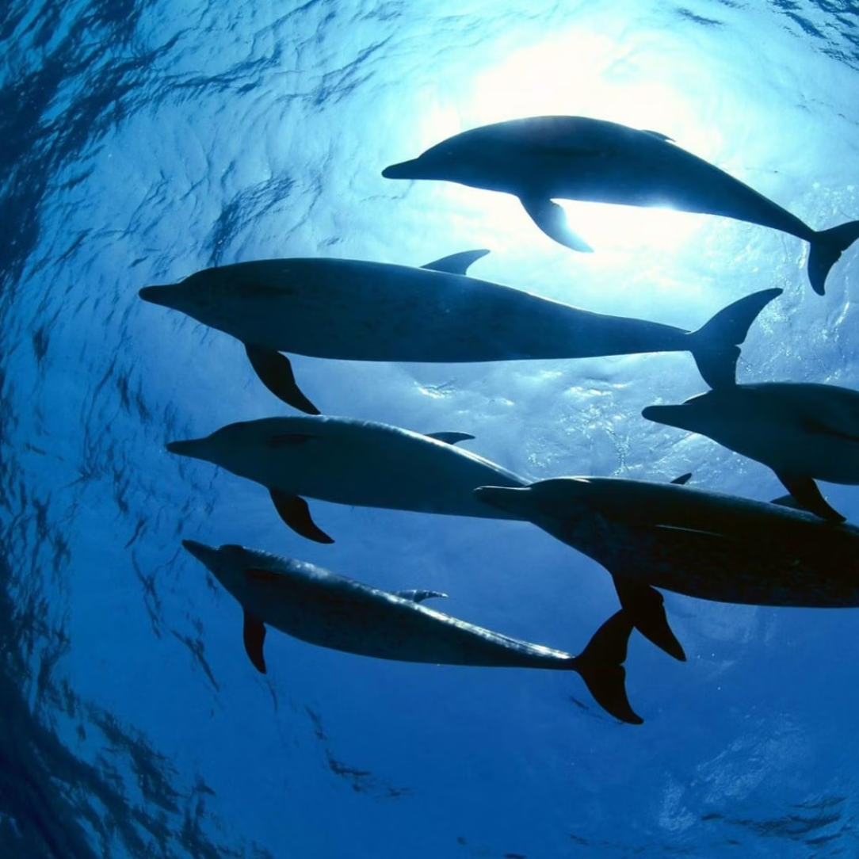
Image Comparison: Sample 1
Low-Resolution Input
Restored Output
Ground Truth (High-Resolution)
The initial input image, demonstrating significant blurriness and lack of detail.
The image after model processing. There's still noticeable blur, suggesting room for refinement.
The original, high-quality image used as the benchmark for restoration, showcasing desired clarity.
This comparison visually highlights the progress and remaining challenges in the image restoration process. The restored image is still quite far from the ground truth, indicating a need for model enhancements.

Slide 7
Final Evaluation Metrics
At the culmination of the training process, the model achieved the following key performance indicators:
31.2
0.87
Final PSNR
Final SSIM
A high PSNR value of 31.2 dB demonstrates the model's ability to reduce noise and enhance the signal quality of restored images. But the values must be higher
An SSIM score of 0.87 indicates strong structural similarity, meaning the restored images closely resemble the ground truth in terms of perceptual quality. This value has to be much lower
These final metrics provide a quantitative summary of the model's overall performance on the test dataset.

Slide 8
Robust Error Handling
To ensure the integrity and reliability of our image processing pipeline, we've implemented robust error handling mechanisms.
Image Loading Checks
Valid Input Assurance
OpenCV & Matplotlib Integration
Comprehensive checks are in place to validate image file integrity and format, preventing processing errors due to corrupted or incompatible inputs.
Before any comparisons or metric calculations, strict validation ensures that all input images conform to the expected dimensions and data types.
Leveraging the robust capabilities of OpenCV for image processing and Matplotlib for visualisation, our system ensures accurate data handling and presentation.

Slide 9

Key Takeaways
1
Model Improvement
2
Restoration Gap Remains
3
Changing model is required
The model starts improving but at point the learning curve shows that the training data and validation data becomes linear hence adding more epochs doesn't help hence we might have to change the model core or increase data set,.
While progress is evident, restored images are still extremely visually distinct from the ground truth, highlighting a need for further model refinement.
Completely changing the model from scrnn is required as we are not getting the desired output

Slide 10




Future Directions
Model Architecture
Explore EDSR and ESRGAN for better outcomes in project as the current model is underperforming
Dataset Expansion
Integrate larger and more diverse datasets to enhance the model's robustness and generalizability.
Hyperparameter Tuning
Conduct rigorous fine-tuning of hyperparameters to optimise model performance and convergence speed.
Constraint, since our model is limited to 60 test 20 validation and 20 test data sets, we need to get a better model as increasing data set is not an option

Slide 11
Github Link

